Slide 1
What is Literature?
Introduction to English Literature(04)
March 12, 2025
Chankil Park

Slide 2
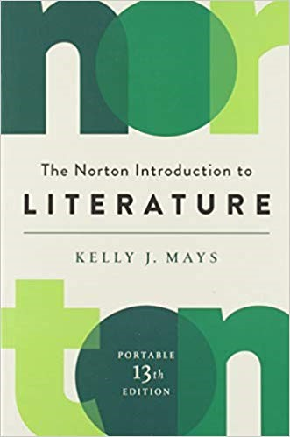
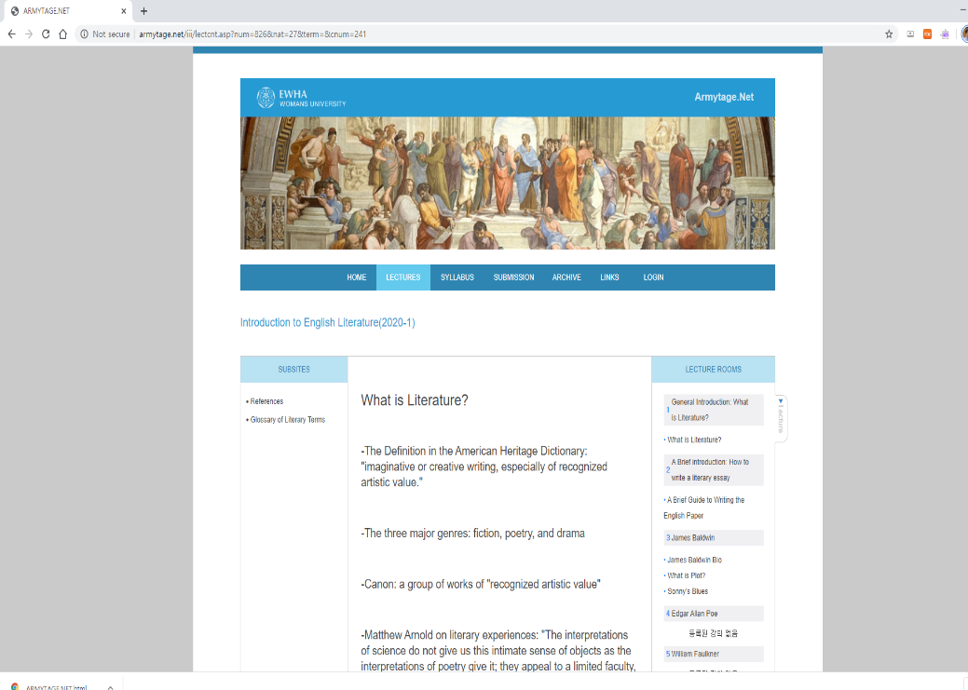
Text & Website
Text
Website: armytage.net

Slide 3
Definition
Imaginative or creative writing,
especially of recognized artistic value
From American Heritage Dictionary

Slide 4
Three Major Genres
Fiction
Poetry
Drama

Slide 5
Canon
A group of works of “recognized artistic value”

Slide 6
The Value of Literature
Matthew Arnold
"The interpretations of science do not give us this intimate sense of objects as the interpretations of poetry give it; they appeal to a limited faculty, and not to the whole man. It is not Linnaeus...who gives us the true sense of animals, or water, or plants, who seizes their secret for us, who makes us participate in their life; it is Shakespeare ...Wordsworth... Keats(4)."

Slide 7
John Keats's "On First Looking into Chapman's Homer"
Much have I traveled in the realms of gold
And many goodly states and kingdoms seen;
Round many western islands have I been
Which bards in fealty to Apollo hold.
Oft of one wide expanse had I been told
That deep-browed Homer ruled as his demesne;
Yet never did I breathe its pure serene
Till I heard Chapman speak out loud and bold:
Then felt I like some watcher of the skies
When a new planet swims into his ken;
Or like stout Cortez when with eagle eyes
He stared at the Pacific—and all his men
Looked at each other with a wild surmise—
Silent, upon a peak in Darien.

Slide 8
What is “Sonnet”?
A lyric poem, a single stanza of fourteen iambic pentameter, the hopes and pains of an adoring male lover.
The Italian or Petrarchan sonnet (named after the fourteenth century Italian poet Petrarch) falls into two main parts: an octave (eight lines) rhyming abbaabba followed by a sestet (six lines) rhyming cdecde or some variant, such as cdccdc. Introduced by Thomas Wyatt in the 16th century.
The Earl of Surrey(Henry Howard) in the sixteenth century also developed a stanza form called the English sonnet, or the Shakespearean sonnet, after its greatest practitioner. This sonnet falls into three quatrains and a concluding couplet: abab cdcd efef gg.

Slide 9
Shakespeare’s Sonnets
The primary source of Shakespeare’s sonnets is a quarto published in 1609 titled Shakespeare’s Sonnets. It contains 154 sonnets".
The sonnets cover such themes as the passage of time, love, infidelity, jealousy, beauty and mortality. The first 126 are addressed to a young man; the last 28 are either addressed to, or refer to a woman.

Slide 10
John Keats's "On First Looking into Chapman's Homer"
Much have I traveled in the realms of gold And many goodly states and kingdoms seen;
Round many western islands have I been
Which bards in fealty to Apollo hold.
Oft of one wide expanse had I been told
That deep-browed Homer ruled as his demesne;
Yet never did I breathe its pure serene
Till I heard Chapman speak out loud and bold:
Then felt I like some watcher of the skies
When a new planet swims into his ken;
Or like stout Cortez when with eagle eyes
He stared at the Pacific—and all his men
Looked at each other with a wild surmise—
Silent, upon a peak in Darien.
나는 황금의 땅도 많이 여행했고, 훌륭한 나라들과 왕국들도 많이 봤다. 아폴로를 섬기는 시인들이 사는
서쪽의 섬들도 많이 가봤다.
나는 어떤 넓은 땅에 대한 얘기를 들어왔는데, 그곳은 주름살 깊은 호머가 군림하는 그의 영토였다. 하지만 나는 그 땅의 순수하고 조용한 대기를 들이마실 수 없었다. 채프만이 크고 대담하게 말하는 소리를 들었을 때까지. 그때 나는 하늘의 관찰자들이 새로운 행성의 움직임을 포착했을 때 같은 그런 기분이었다.
혹은 모든 부하들이 황당한 추측 속에 서로를 쳐다보는 가운데,
강건한 코르테즈가 그의 독수리같은 눈매로 다리안의 산꼭대기에서 조용히
태평양을 노려보았을 때 같은 그런 기분이었다.

Slide 11
Comments from the Text
﻿"the subjective experience of reading and the complex sensations it inspires--the dizzying exhilaration of discovery; the sense of power, accomplishment, and pride that comes of achieving something difficult; the wonder we feel in those rare moments when a much-anticipated experience turns out to be even greater than we had imagined it would be(5)."
"the sensual qualities-the way the words look, sound, and even feel in our mouths because of the particular way they are put together on the page. The sensation of excitement--of a racing heart and mind--is reproduced in us as we read the poem(5)."

Slide 12
“Meter” in English Poetry
The recurrence, in regular units, of a prominent feature in the sequence of speech-sounds of a language.
A foot is the combination of a strong stress and the associated weak stress or stresses which make up the recurrent metric unit of a line.
Iambic(약강), Anapestic(약약강), Trochaic(강약), and Dactylic(강약약)

Slide 13
Names of Metric Lines
monometer: one foot
dimeter: two feet
trimeter: three feet
tetrameter: four feet
pentameter: five feet
hexameter: six feet (an Alexandrine is a line of six iambic feet)
heptameter: seven feet
octameter: eight feet

Slide 14
An Example of “Dactylic Tetrameter”
Rain drops on roses and whiskers on kittens
Bright copper kettles and warm woolen mittens
Brown paper packages tied up with strings
These are a few of my favorite things
Cream colored ponies and crisp apple streudels
Doorbells and sleigh bells and schnitzel with noodles
Wild geese that fly with the moon on their wings
These are a few of my favorite things
Girls in white dresses with blue satin sashes
Snowflakes that stay on my nose and eyelashes
Silver white winters that melt into springs
These are a few of my favorite things
When the dog bites
When the bee stings
When I'm feeling sad
I simply remember my favorite things
And then I don't feel so bad

Slide 15
An “Iambic Pentameter” sung by a rapper
Shall I compare thee to a summer’s day?
Thou art more lovely and more temperate:
Rough winds do shake the darling buds of May,
And summer’s lease hath all too short a date;
Sometime too hot the eye of heaven shines,
And often is his gold complexion dimm'd;
And every fair from fair sometime declines,
By chance or nature’s changing course untrimm'd;
But thy eternal summer shall not fade,
Nor lose possession of that fair thou ow’st;
Nor shall death brag thou wander’st in his shade,
When in eternal lines to time thou grow’st:
So long as men can breathe or eyes can see,
So long lives this, and this gives life to thee.

